Slide 1





12/03/2024
Google Play Analytics
95%
Tachin Ho
Kobbie Antwi
Somya Garg

Slide 2
Why We Chose This Data
95%
Actionable Insights
Focus on App Quality
The Rating variable reflects user satisfaction, helping identify features like size and price that boost ratings.
Developers can optimize features and improve retention, while businesses use insights to guide promotions and target key categories.
High-Quality Dataset
Business Relevance
The dataset is clean and includes derived features like Log_Installs for improved predictions.
Predictive insights help allocate resources effectively, improve app features, and target underserved categories for growth.

Slide 3
Data Transformation
95%
Objective: Clean and prepare data for analysis.
Steps:
Handled missing values: Removed invalid Rating and imputed Size.
Standardized columns: Converted Reviews, Installs, Price to numeric.
Feature Engineering: Added Log_Installs, days_since_update, and Price_Installs.
Simplified categories: Grouped rare genres and extracted primary Genres.
Scaled numeric columns: Standardized features like Size and Rating.
Notes:
In data transformation, we focused on cleaning and standardizing the dataset to ensure high-quality inputs for modeling. Key steps included handling missing values, converting text to numeric columns, and scaling features for consistency. We also engineered new features like log-transformed installs and interaction effects to capture relationships more effectively. This ensures our dataset is robust for predictive modeling.

Slide 4
Data Exploration
Objective: Identify key relationships and patterns.
Findings:
Rating: Concentrated in the 4-5 range, showing user positivity.
Installs & Reviews: Skewed, with a few apps dominating.
Positive correlations: Higher installs and reviews boost ratings.
Recent updates improve ratings; free apps outperform paid ones.
Visuals: Scatter plots, histograms, and heatmaps confirm trends.

Slide 5
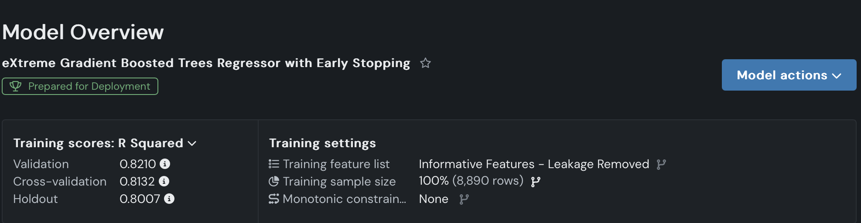
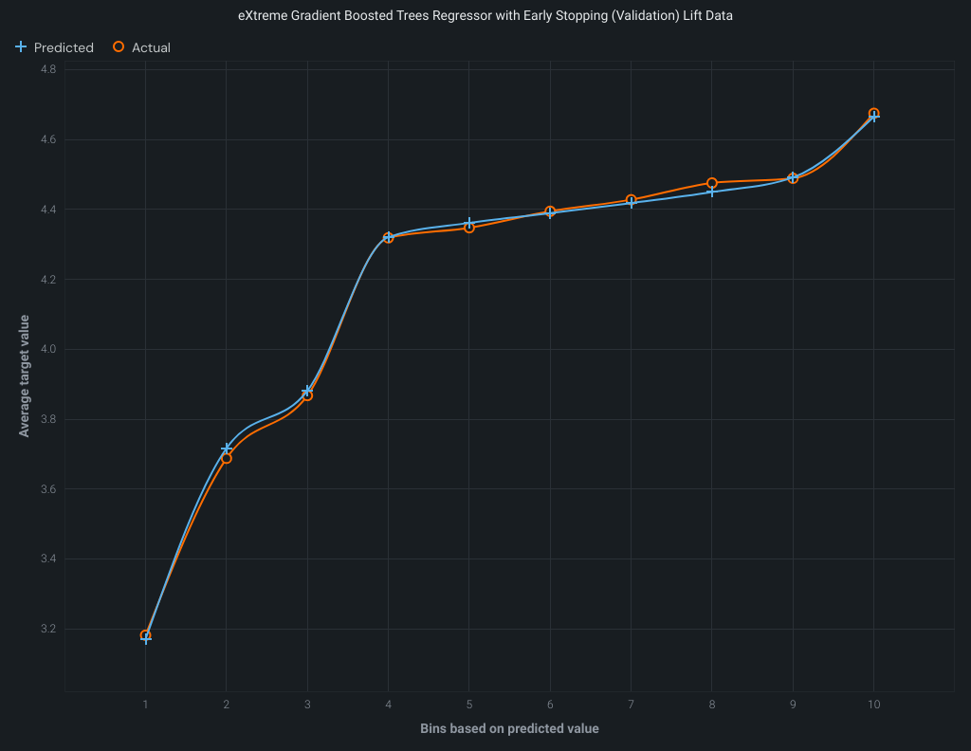
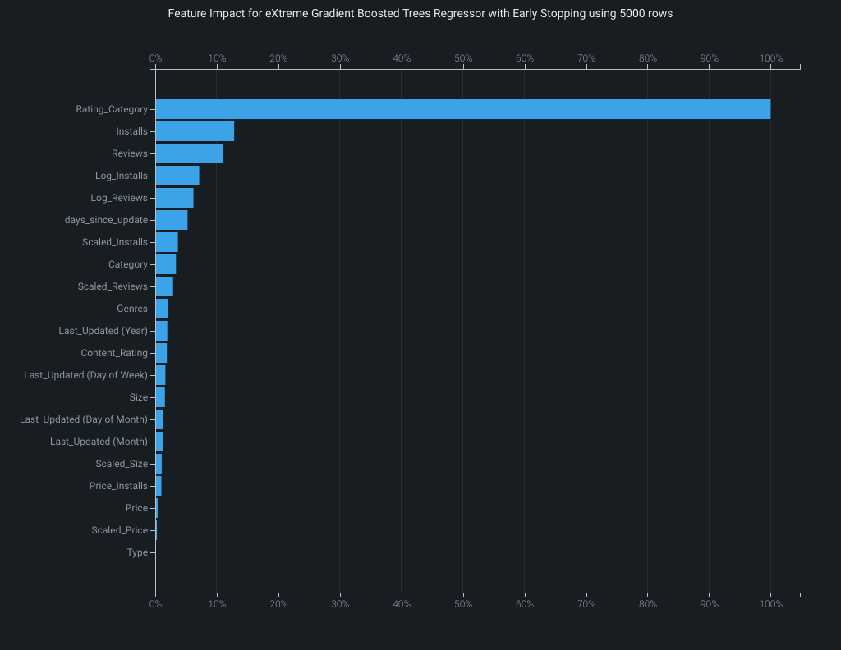
95%
SHAP - Average effect of each feature on prediction

Slide 6
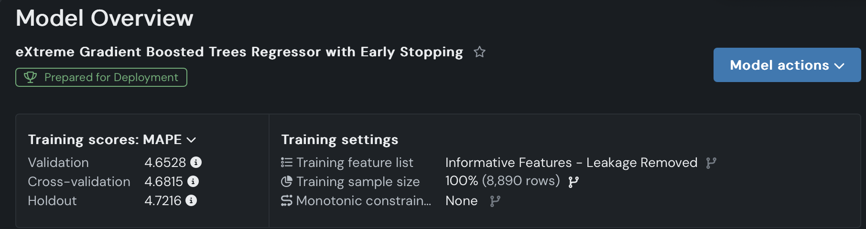
95%

Slide 7
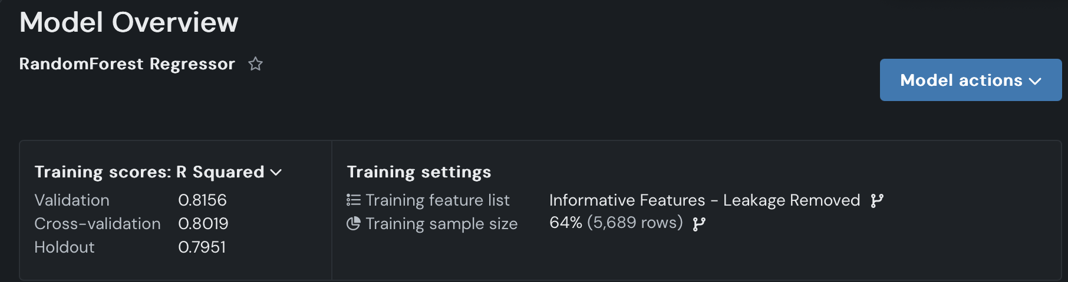
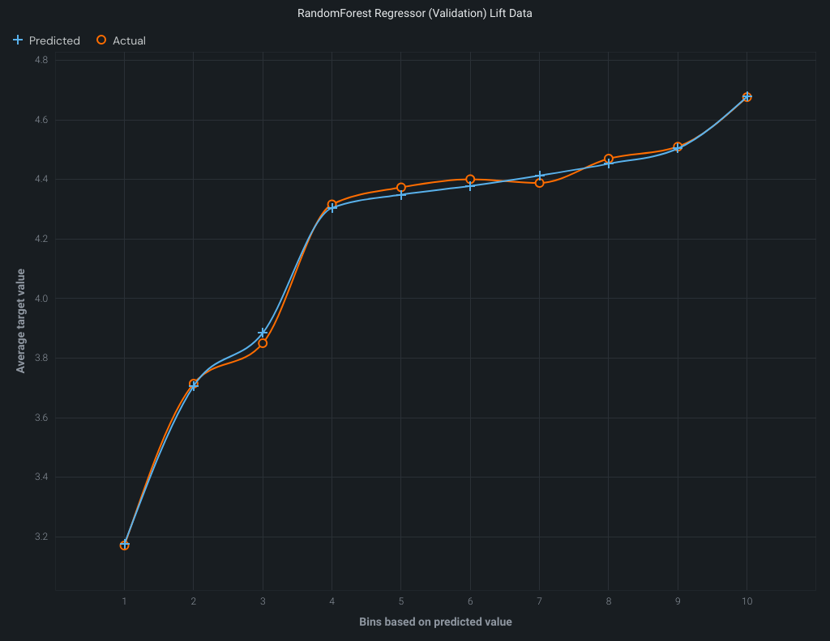
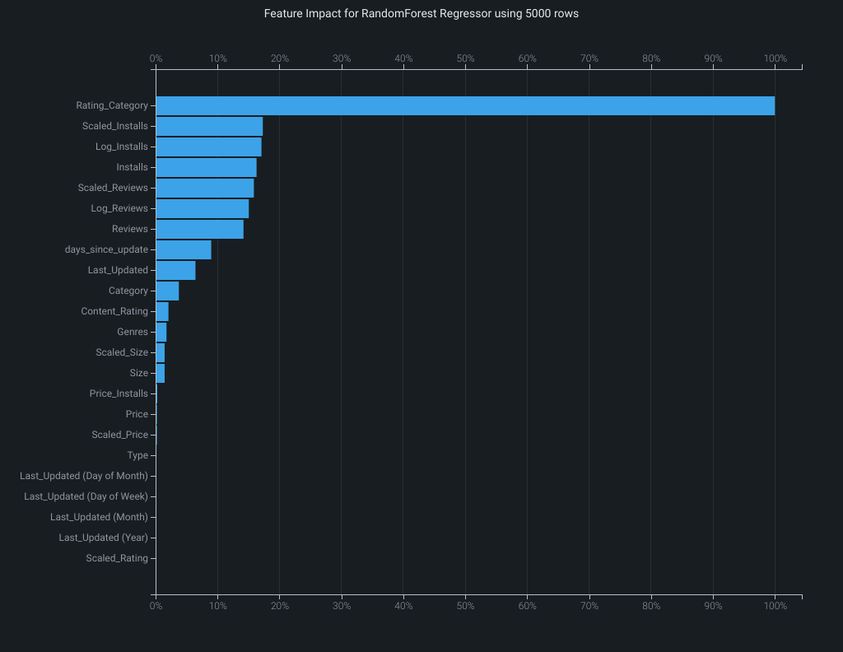

Slide 8
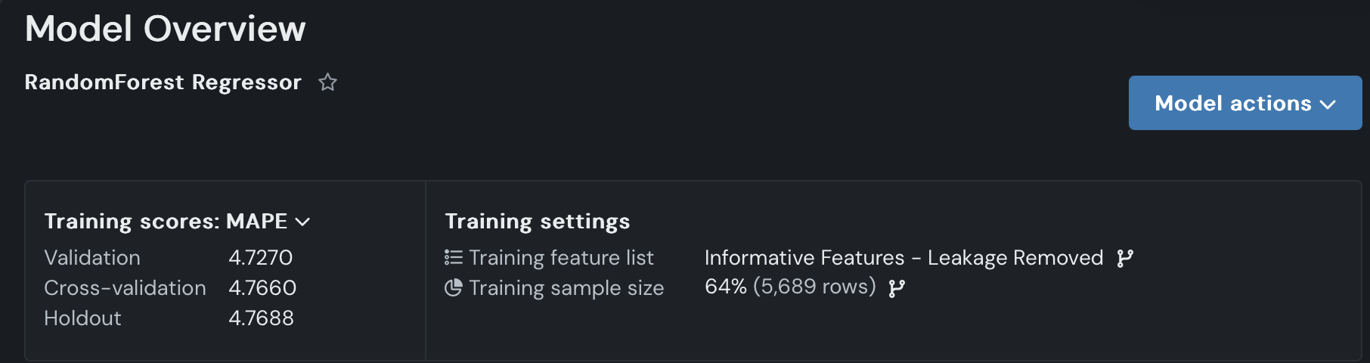
95%

Slide 9
Data Insights
95%
Challenges
Results
Solutions
Choosing the right data is a challenge due to various considerations, such as data cleaning, identifying valuable insights, and selecting the relevant topics to analyze.
The top three variables impacting app performance are :
1. Rating Categories (High/Medium/Low)
2. Installs
3.Reviews
Optimize Reviews and Installs to boost visibility and satisfaction.
Leverage Rating Categories to target improvements and user segments.

Slide 10
12/03/2024
Thanks!
95%
Do you have any questions?
Please keep this slide for attribution

